Slide 1
Functions returning values
Python: Next steps
3rd Edition

Slide 2
Objectives
Define a function which calculates a value and passes it back to the calling module
Call a function which calculates a value
Assign the return value to a variable in the calling module

Slide 3
Starter
Work out which is the biggest in each list of numbers:
[83, 104, 96, 83, 29, 10]
[16, -37, 29, -12]
[42, 193, -647, 583, 12, -62]

Slide 4
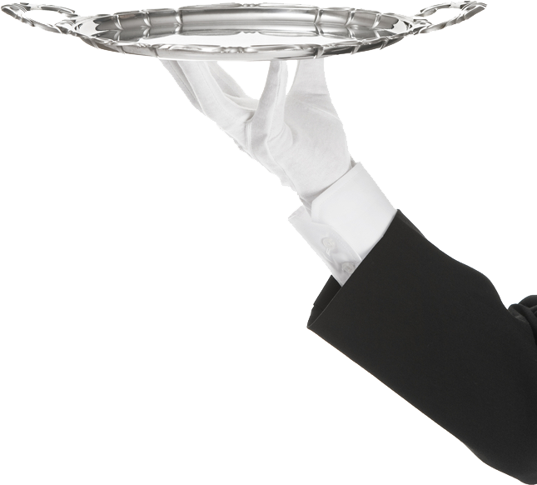
Functions
A function is a piece of code that you can run whenever you want to
Imagine having a butler who can tie your shoe laces, cook your tea or change the TV channel
BUT sometimes you want the butler to answer a question

Slide 5
Functions returning answers
A function can send an answer back
So your butler can also tell you the answer to that maths question, remind you when your favourite TV show is on or work out the quickest way to get to the cinema

Slide 6
Functions
Try this code:
def calcDouble(amount):
amount = 2 * amount
return amount
question = 120
answer = calcDouble(question)
print(“Double”,question,”is”,answer)

Slide 7
Functions
def calcDouble(amount):
amount = 2 * amount
return amount
When you call the function, the value of question gets sent to calcDouble(amount)
The function does some working out and returns the result

Slide 8
Defining functions
Add two more functions to your existing program
They must go BEFORE the main program:
calcHalf(amount)
calcTenMore(amount)

Slide 9
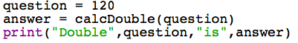
Calling functions
In your main program (underneath the functions), you should already have this code:
Add two more lines of code that will:
Call calcHalf() and store the result in answer
Print out a suitable message
Repeat for calcTenMore()

Slide 10
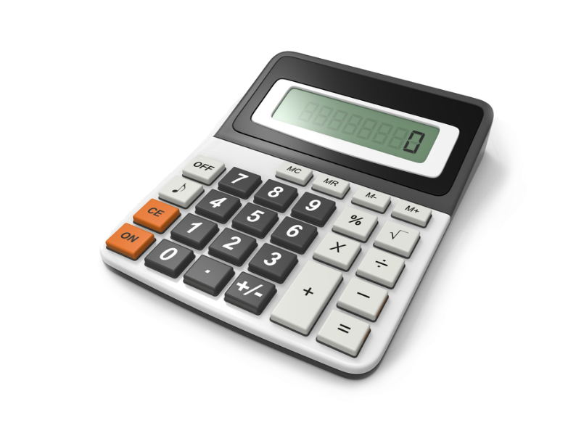
Programming task
Edit the program calculator.py
Add 3 more functions:
subtract
divide
multiply
Complete the if / elif blocks to finish the program

Slide 11
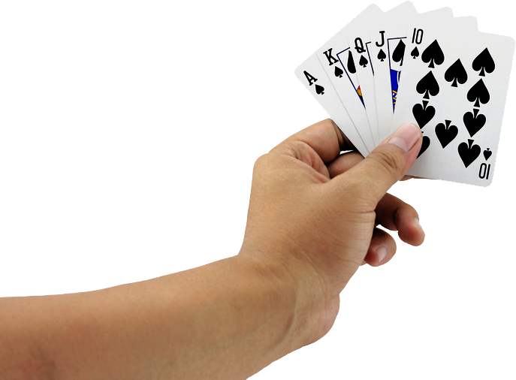
Worksheet 5
To practise your programming skills, complete the worksheet to start making a card game

